Slide 1

基于MindSpore的Falcon大模型迁移与性能研究
Flash Attention & triton(stage 3)
Week 13
曾子瑄
2024.01.25
Notes:
照片为学生拍摄的礼堂

Slide 2
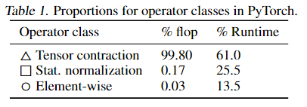
Motivation
Equipping Transfomers with longer context is difficult
The self-attention module has time and memory complexity quadratic in sequence length.
Current approaches do not display wall-clock speedup because they focus on FLOP reduction and tend to ignore overheads from memory access.
Data Movement is All You Need, MLSys 2021

Slide 3
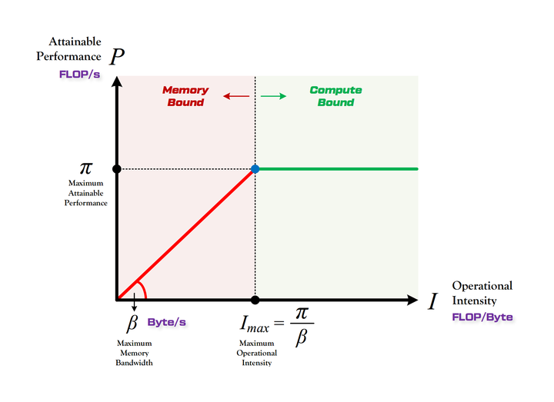
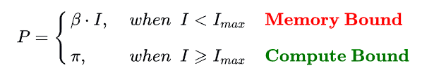
Motivation
Roofline Model

Slide 4
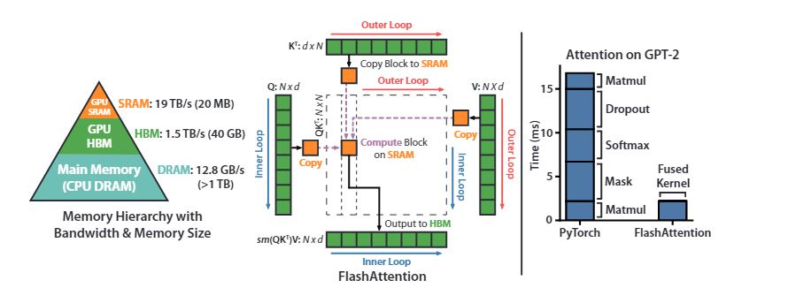
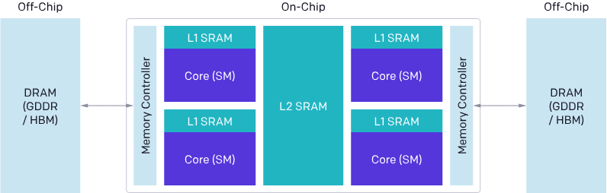
Flash Attention
FLOPS & I/O complexity

Slide 5
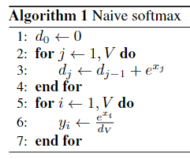


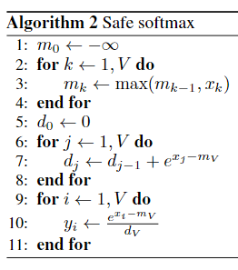
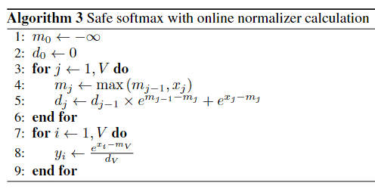
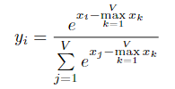
Online Softmax
FP16
Online normalizer calculation for softmax

Slide 6
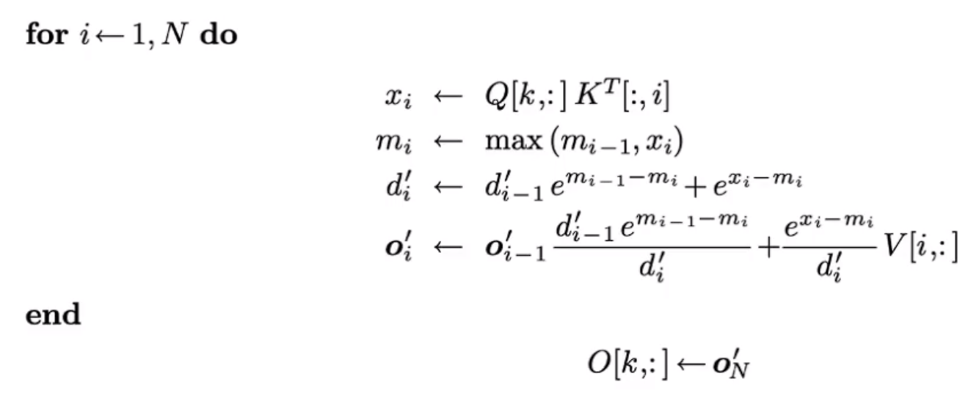
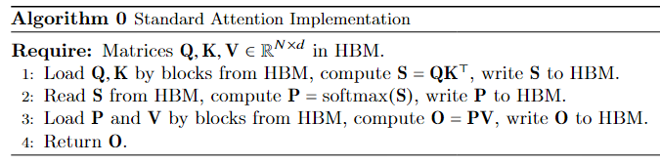
Flash Attention

Slide 7
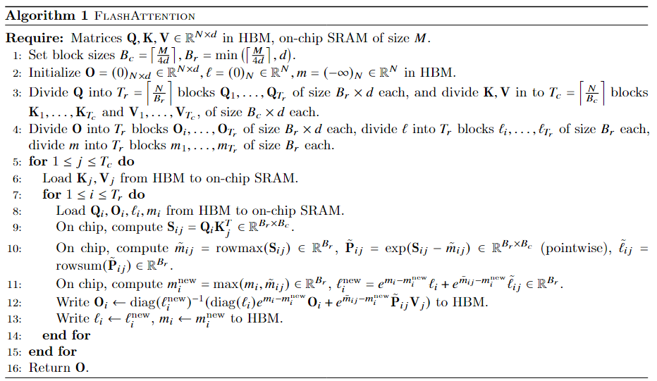
Flash Attention

Slide 8

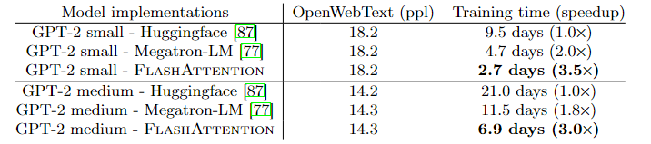
Experiments

Slide 9
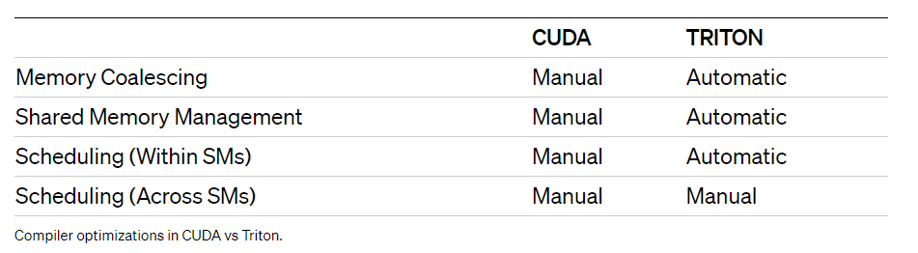
Triton
Triton is a language and compiler for parallel programming. It aims to provide a Python-based programming environment for productively writing custom DNN compute kernels capable of running at maximal throughput on modern GPU hardware.

Slide 10


